Slide 1
PowerShell for Office 365
SharePoint Saturday Phoenix 2014

Slide 2



Agenda
Speaker
PS4O365
Prereqs
Resources
Demo

Slide 3
Speaker

Slide 4
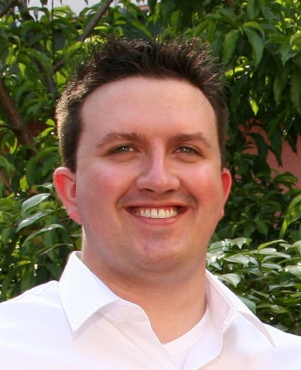
Eric Skaggs
http://www.skaggej.com
@skaggej
eskaggs@outlook.com
Catapult Systems
Pluralsight Author
Content: http://1drv.ms/1x7lHiR

Slide 5
Company Overview
An independent wholly owned subsidiary of CSI since 2013
Privately founded in 1993, Austin Texas Headquarters
550+ employees (U.S.)
Delivered over 5,000 client engagements
National Coverage with offices in 10 cities:
– Austin
– Dallas
– Denver
– Ft. Lauderdale – Houston
– Phoenix
– San Antonio
– Seattle
– Tampa
– Washington D.C.

Slide 6


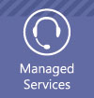


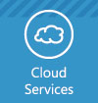






Who We Are
“The Microsoft Consulting Company”
Microsoft National Systems Integrator (NSI)
100% Microsoft focused
We provide:
Infrastructure
Business Intelligence
Managed Services
User Centered Design
Web Solutions
Cloud Services
Custom Applications
Mobile Solutions
Testing/Test Automation
Service Engineering
Global Delivery
Global Service Center
*90% of our employees maintain at least one Microsoft professional certification*

Slide 7
Microsoft Competencies
With 13 gold and 4 silver competencies to date, Catapult Systems ranks in the top 0.10% of Microsoft partners globally.
GOLD COMPETENCIES
SILVER COMPETENCIES
Application Development
Business Intelligence
Collaboration and Content
Communications
Customer Relationship Management
Devices and Deployment
Hosting
Management and Virtualization
Messaging
Midmarket Solution Provider
Mobility
OEM
Small Business​
Application Integration
Data Platform
Identity and Access
Server Platform​

Slide 8
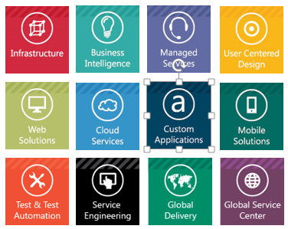
End-To-End Services
Infrastructure
Business Intelligence
Managed Services
Systems Management
Virtualization
Device Management
Unified Communications
Enterprise BI Strategy
A3 Methodology
Custom Apps
Exchange
Lync
Office 365
SharePoint
SQL Server
System Center
Windows Server
User Centered Design
Web Solutions
Cloud Services
UCX Workshop
User Adoption
Visual Design
Intranet
Extranet
Public Facing
Office 365
Azure
Intune
Custom Applications
Mobile Development
Testing/Test Automation
Custom Development
xRM/CRM Solutions
Mobile Application Development
Enterprise Mobility Solution
Test Management
Test Automation & Execution

Slide 9
End-To-End Services - Continued
Service Engineering
Global Service Center
Global Delivery
Unparalleled Operations Excellence
24x7 Global Service metric-ed on established BI tools unique to our processes
Large Scale Enterprise Services
Migrations
Test/Test Automation
Support
Global Delivery Practice
Mature Process
Operation Excellence
Best Practices for SMAC enablement

Slide 10
PowerShell for Office 365

Slide 11
Why?
Portal Management
Import Users
Assign Licenses to Users
View Licensed Users
Perform Bulk Tasks
Create site collections
Do things that can’t be done in the user interface

Slide 12
Prerequisites

Slide 13
Prerequisites
Global Admin - Be one!
Microsoft Online Services Sign-In Assistant
Azure Active Directory Module for Windows PowerShell (64-bit version)
Connect-MsolService
Connect-SPOService
Be careful of your network settings! (http://bit.ly/1AjffaQ)

Slide 14
Resources

Slide 15
PowerShell for Office 365 Resources
Check out the Links page
GitHub

Slide 16
Demo

